Slide 1
Roman City Structure

Slide 2
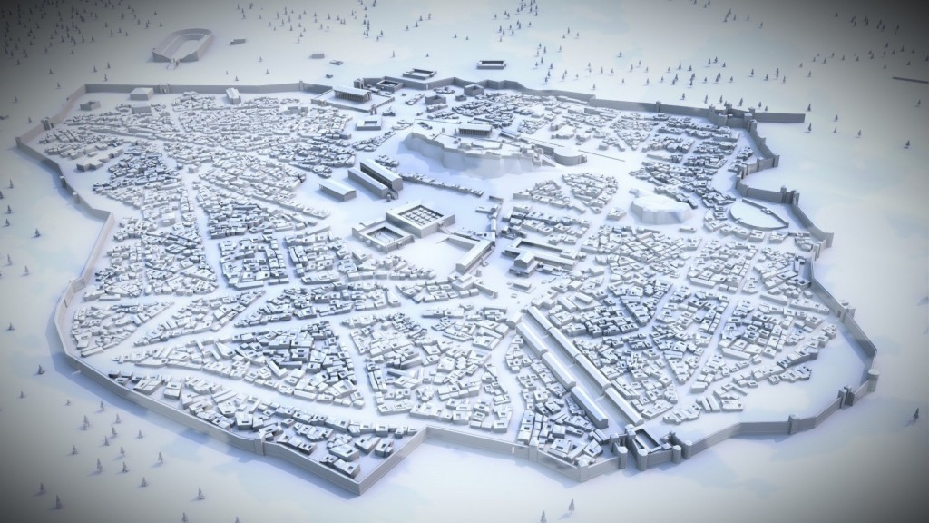
Digital Reconstruction of Roman Athens

Slide 3
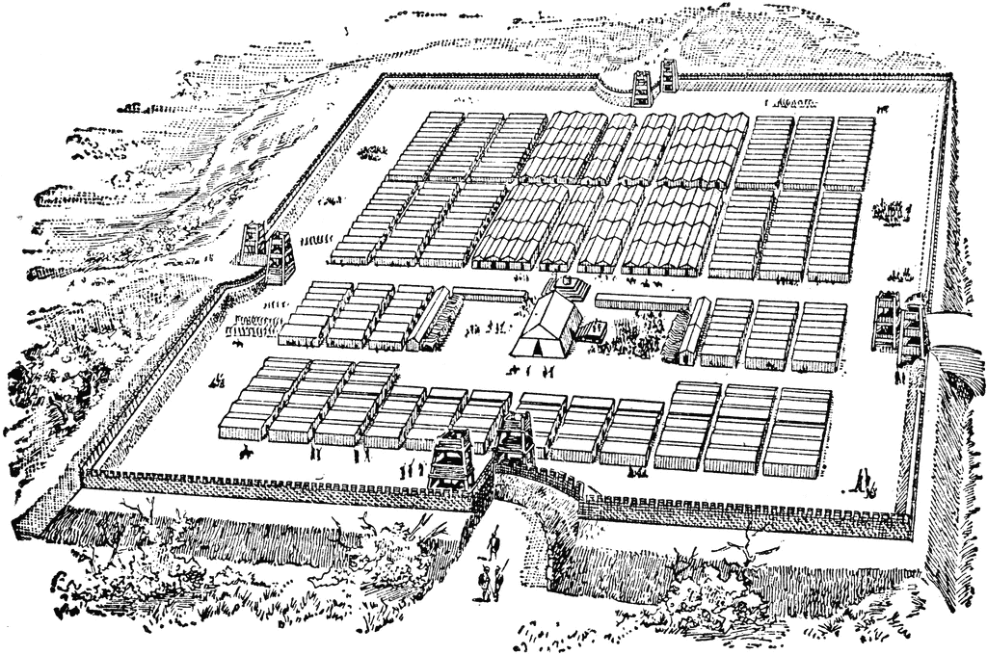
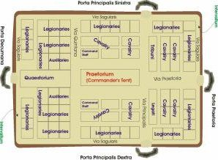
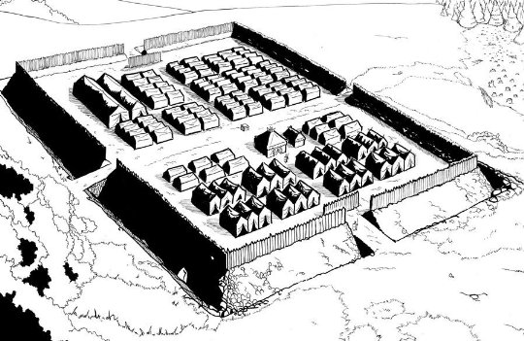
Hippodamian grid
Hippodamus of Miletus (498-408 BC)
Roman military camps inherited this system
Most colina or colonies were founded my military veterans who were used to this system.

Slide 4
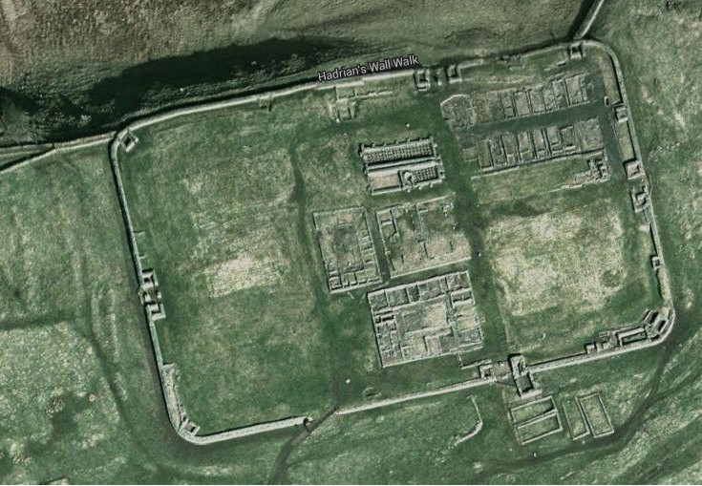
Roman castra or fort on Hadrian’s Wall in Britain

Slide 5
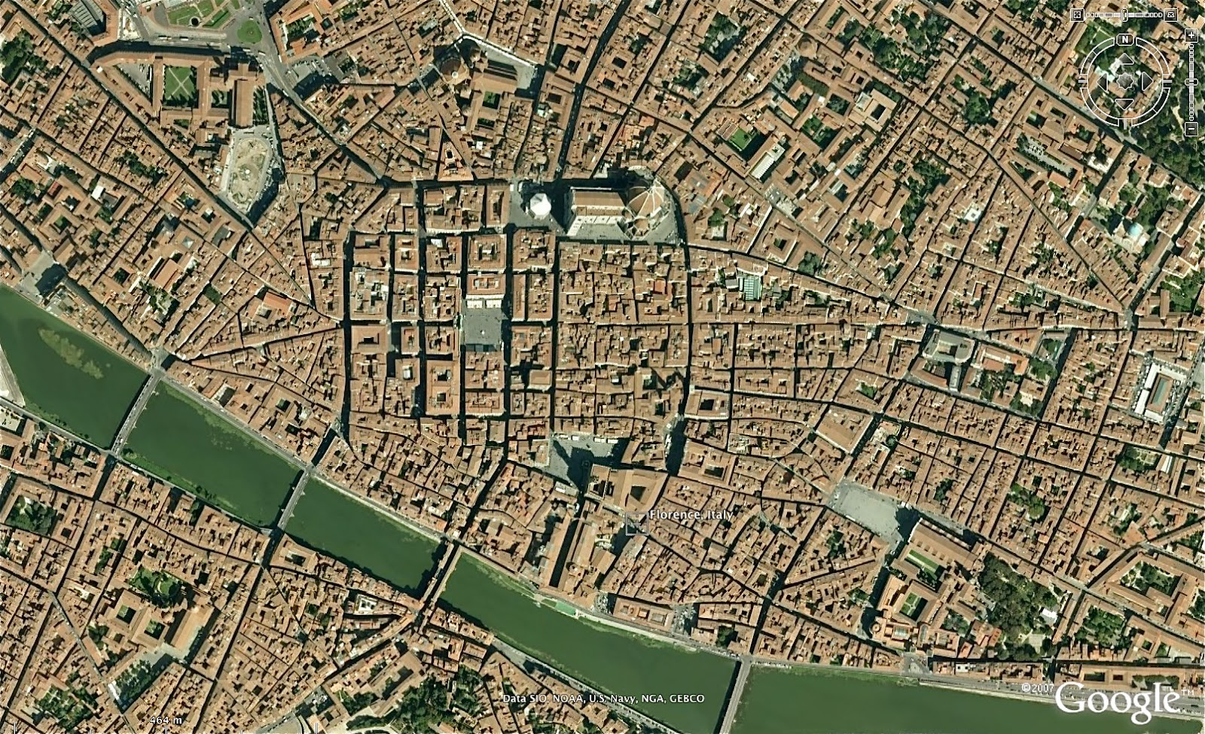
Roman Center of Florence

Slide 6
Basic Layout
Two main roads
Cardo Maximus which runs North-South
Decumanus Maximus which runs East-West
Cardo Maximus
Hub of economic life
Cardo roughly means hinge or axis
Decumanus Maximus
From decimana (tenth) because it separated the 9th and 10th cohorts in legionary encampments
Intersect at the Groma
Surveying tool with a cross of plumb lines
Placed at center to survey the possible city.

